Slide 1
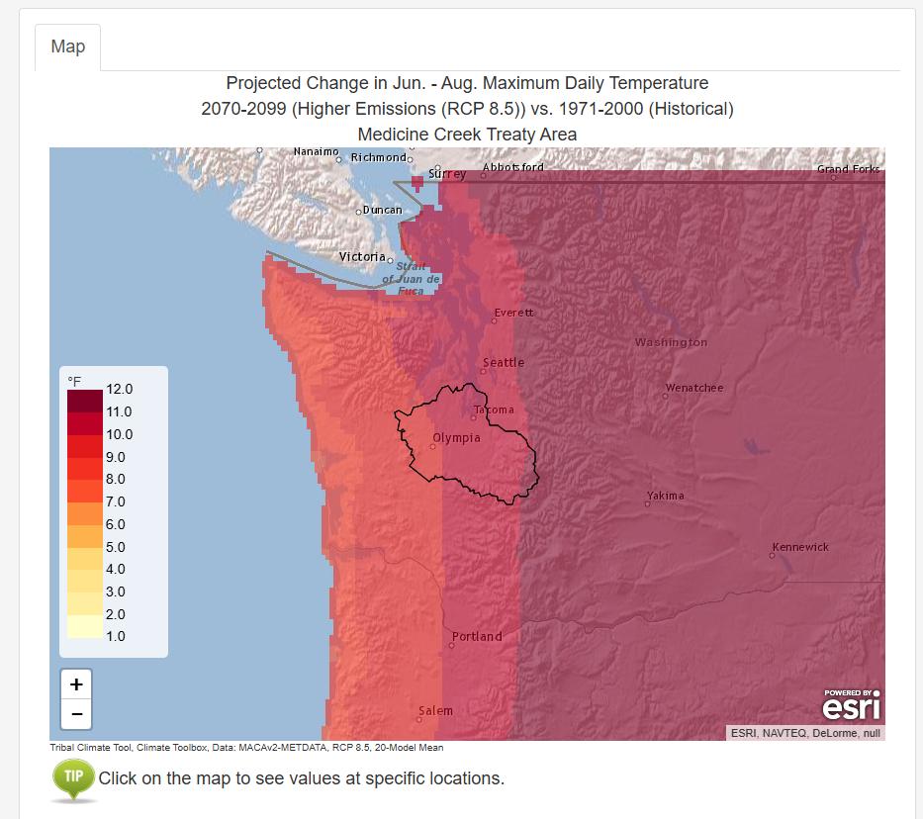
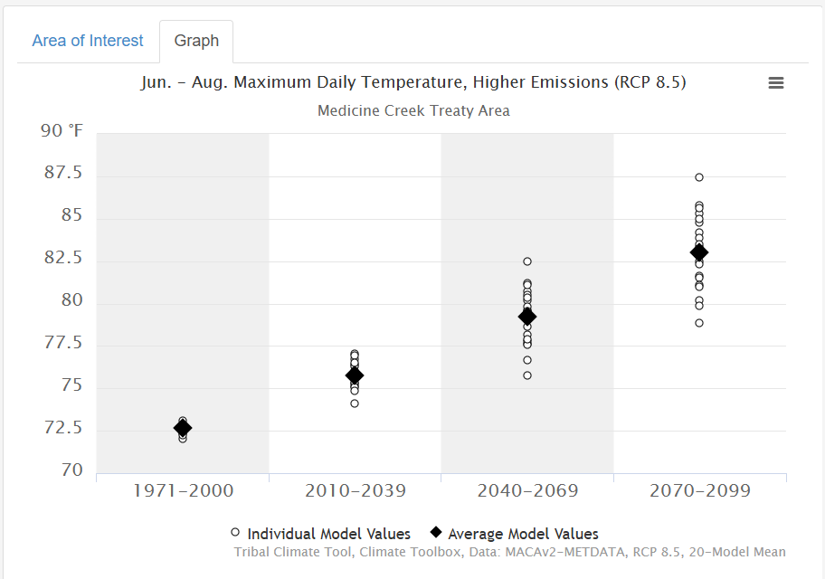
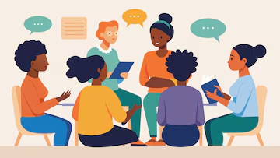
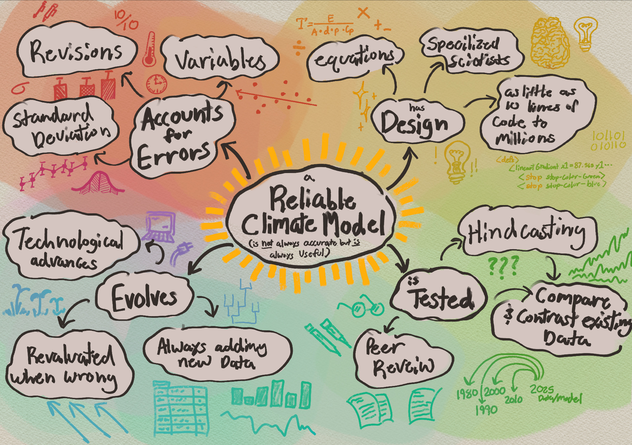
KNOW Week Two:
Tribal Climate Tool Colloquium

Slide 2
Instructions
In class on today and Wednesday
Choose a Pacific Northwest Tribe from Oregon State University’s Tribes of the Pacific Northwest Region. Indicate your selection on this Google Sheet.
Use the tribes website (linked on OSU’s page) and additional online resources to explore the tribe’s history, culture, and connection to nature. Use the Tribal Climate Tool to see how climate variables are expected to change on the tribe’s land. This document provides space to record insights.
Create a 1-page handout with hand-drawn visuals that symbolize the most essential points of your findings and discussion. Take this in any direction your group wants. For example, the visual could use a metaphor or be created in the style of a community mural, a tattoo sleeve, a map, or a music album cover.
In class on Friday
You will present your 1-pager and synopsis of your group research to other small groups of students. You will then facilitate a discussion.
Your team will record the evolution of the discussion on chart paper.
Each group will present twice and be presented to twice, we will then debrief as a whole group.

Slide 3
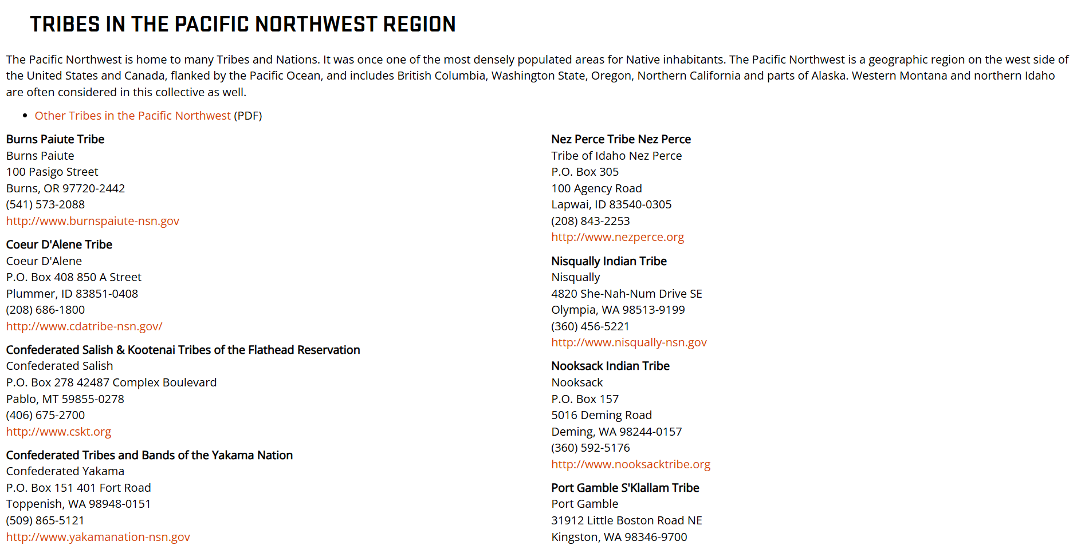

Slide 4
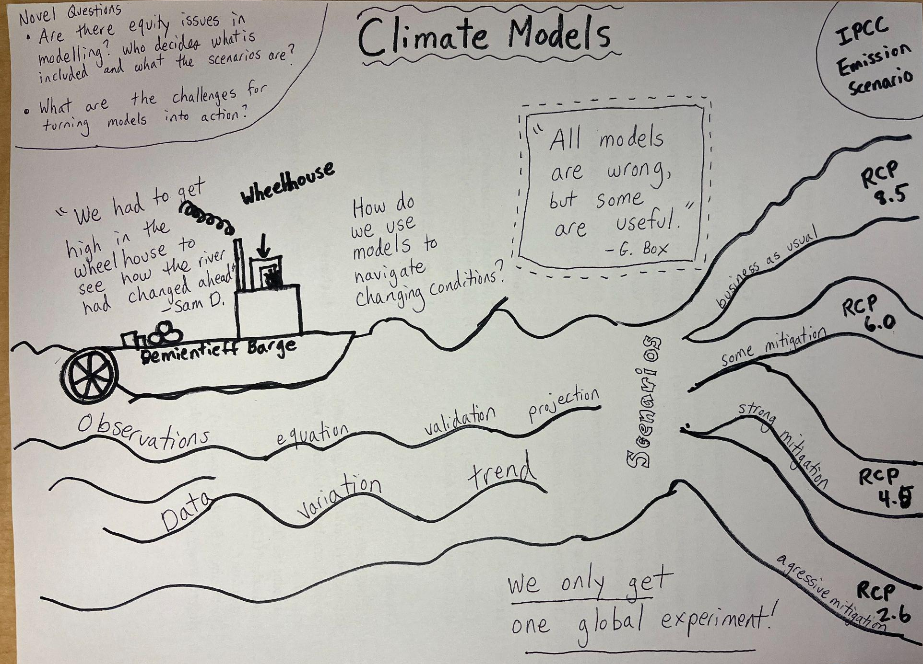

Slide 5
Grading
Group Presentation and discussion leadership - 15 Points
The visual one-pager is appealing and provides enough information to spark further conversation (5 points).
Questions and important points drawn from research using the Tribal Climate Tool and tribe websites are engaging, relevant, and interesting (5 pts)
Presentation is well conveyed and discussion is effectively facilitated during the colloquium (5 pts)
Participant in discussion - 5 Points
The student was engaged and actively contributed to the discussion during both conversations (5 pts)

Slide 6
Expected to use (at least) two primary data sources:
Information from the tribe’s website (linked on Oregon State University’s page)
Climate projections on the tribe’s lands from the University of Washington Climate Impact Group’s Tribal Climate Tool

Slide 7
Round One
7
6
3
2
We will talk more about this later!
8
5
4
1

